Slide 1
Introduction to PLSQL
By: Iwan Herdian

Slide 2
About PL/SQL
PL/SQL is the procedural extension to SQL with design features of programming languages.
Data manipulation and query statements of SQL are included within procedural units of code
The above reflects Oracle’s current development plans which are subject to change at any time
Notes:
PL/SQL merupakan gabungan antara SQL dengan bahasa pemrograman yang prosedural seperti COBOL,C dll
PL/SQL tidak mendukung Data Definition Languange (DDL) seperti create table, alter table, atau drop table

Slide 3
Declaring Variables
The above reflects Oracle’s current development plans which are subject to change at any time

Slide 4
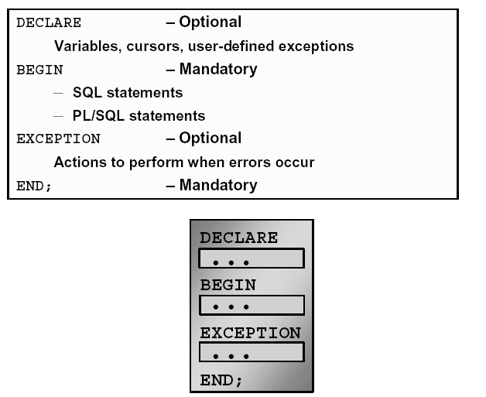
PL/SQL Block Structure
The above reflects Oracle’s current development plans which are subject to change at any time
Notes:
Setiap unit PL/SQL bisat terdiri dari satu atau lebih blok.
Sebuah blok PL/SQL teridiri atas 3 bagian: Declare(pendeklarasian variable), begin(Bagian eksekusi statement) dan exception(penanganan kesalahan)

Slide 5
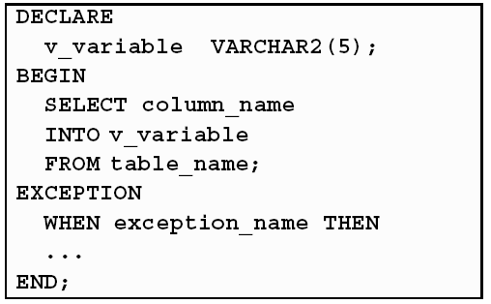
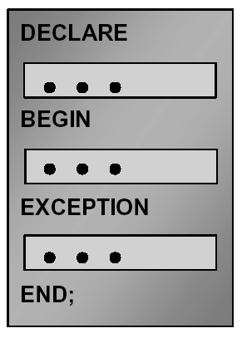
Executing Statements and PL/SQL Blocks
The above reflects Oracle’s current development plans which are subject to change at any time

Slide 6
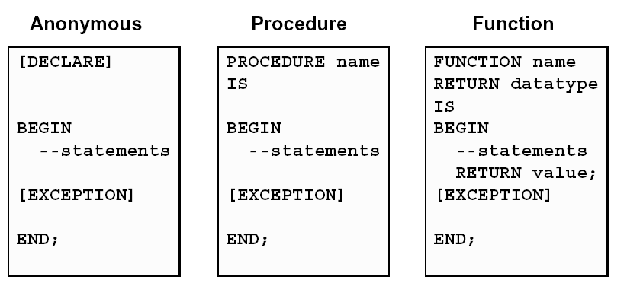
Block Types
The above reflects Oracle’s current development plans which are subject to change at any time

Slide 7
Use Of Variables
Variables can be used for:
Temporary storage of data
Manipulation of stored values
Reusability
The above reflects Oracle’s current development plans which are subject to change at any time

Slide 8
Handling Variables in PL/SQL
Declare and initialize variables in the declaration
section.
Assign new values to variables in the executable
section.
Pass values into PL/SQL blocks through
parameters.
View results through output variables.
The above reflects Oracle’s current development plans which are subject to change at any time

Slide 9
Type Of Variables
PL/SQL variables:
-Scalar
-Composite
Non-PL/SQL variables: Bind and host variables
The above reflects Oracle’s current development plans which are subject to change at any time

Slide 10
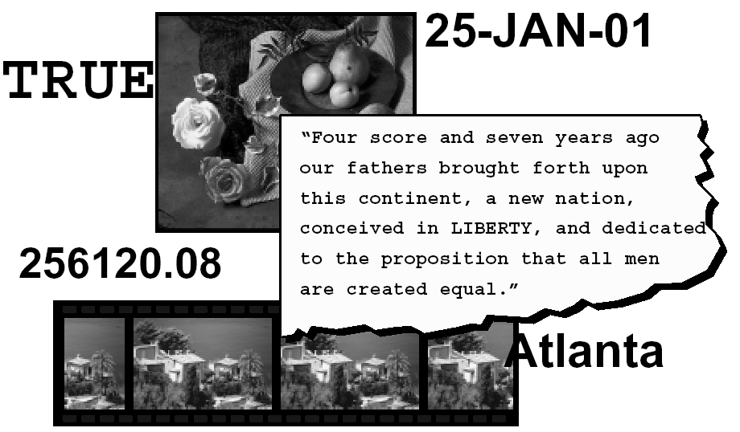
Types Of Variable
The above reflects Oracle’s current development plans which are subject to change at any time

Slide 11
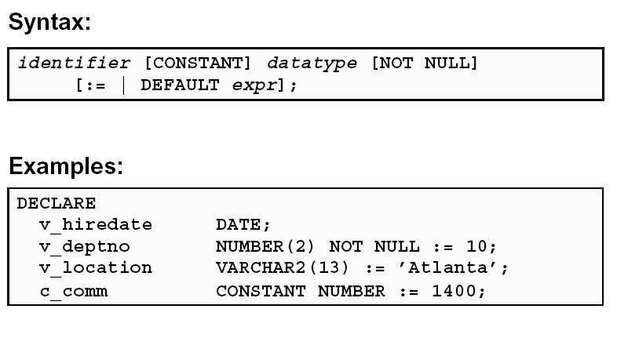
Declaring PL/SQL Variables
The above reflects Oracle’s current development plans which are subject to change at any time

Slide 12

Guidelines for declaring PL/SQL
Follow naming conventions
Initialize variables designated as NOT NULL and CONSTANT
Declare one identifier per line
Initialize identifiers by using the assignment operator (:=) or the DEFAULT reserved word
The above reflects Oracle’s current development plans which are subject to change at any time

Slide 13
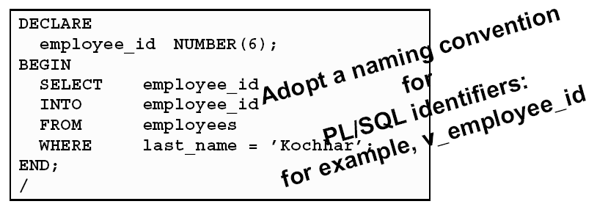
Naming Conventions
Two variables can have the same name, provided they are in different blocks
The variable name (identifier) should not be the same as the name of table columns used in the block
The above reflects Oracle’s current development plans which are subject to change at any time

Slide 14
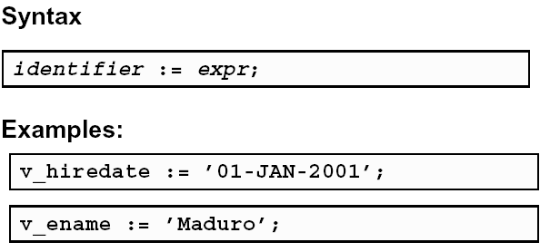
Variable Initialization and keywords
Assignment operator (:=)
The above reflects Oracle’s current development plans which are subject to change at any time

Slide 15
Scalar Data Types
Hold a single value
Have no internal components
The above reflects Oracle’s current development plans which are subject to change at any time

Slide 16
Basic Scalar Data Types
CHAR [(maximum_length)]
VARCHAR2 (maximum_length)
LONG
NUMBER [(precision, scale)]
BINARY_INTEGER
PLS_INTEGER
BOOLEAN
DATE
The above reflects Oracle’s current development plans which are subject to change at any time

Slide 17
Basic Scalar Data Types
Data Type | Description
CHAR | Base type for fixed-length character data up to 32,767 bytes. If you do not [(maximum_length)] specify a maximum_length, the default length is set to 1
VARCHAR2 | Base type for variable-length character data up to 32,767 bytes. There is no (maximum_length) default size for VARCHAR2 variables and constants.
LONG | Base type for variable-length character data up to 32,760 bytes. Use the LONG data type to store variable-length character strings. You can insert any LONG value into a LONG database column because the maximum width of a LONG column is 2**31 bytes. However, you cannot retrieve a value longer than 32760 bytes from a LONG column into a LONG variable.
The above reflects Oracle’s current development plans which are subject to change at any time

Slide 18
Basic Scalar Data Types
Data Type | Description
NUMBER | Number having precision p and scale s. The precision p can range from 1 to [(precision, scale)]. To store floating or fixed
BINARY_INTEGER | Base type for integers between -2,147,483,647 and 2,147,483,647. To store signed integer
PLS_INTEGER | Base type for signed integers between -2,147,483,647 and 2,147,483,647. PLS_INTEGER values require less storage and are faster than NUMBER and BINARY_INTEGER values, because the operations use machine arithmetic
BOOLEAN | Base type that stores one of three possible values used for logical calculations: TRUE, FALSE, or NULL.
DATE | Base type for dates and times. DATE values include the time of day in seconds since midnight. The range for dates is between 4712 B.C. and 9999
The above reflects Oracle’s current development plans which are subject to change at any time

Slide 19
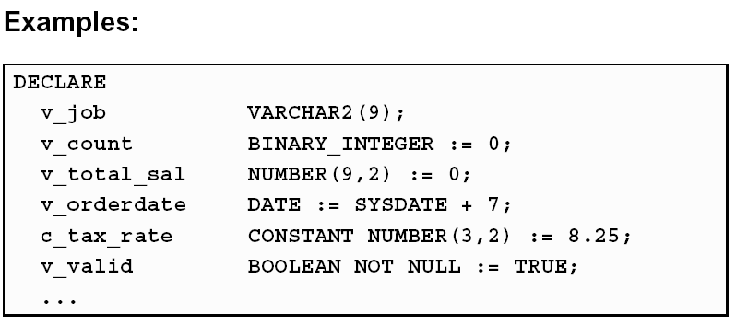
Scalar Variable Declarations
The above reflects Oracle’s current development plans which are subject to change at any time

Slide 20
The %TYPE Attribute
Declare a variable according to:
-A database column definition
-Another previously declared variable
Prefix %TYPE with:
-The database table and column
-The previously declared variable name
The above reflects Oracle’s current development plans which are subject to change at any time

Slide 21
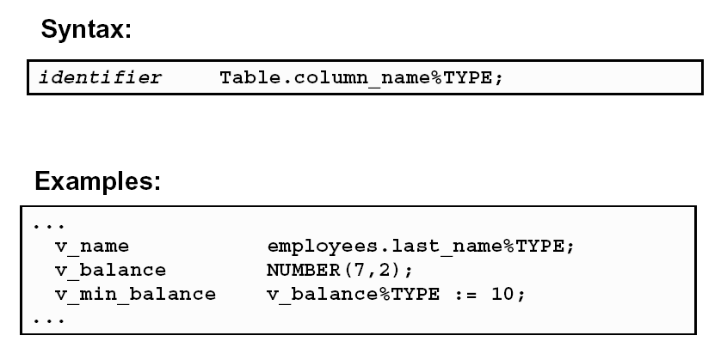
Declaring Variables with the %TYPE Attribute
The above reflects Oracle’s current development plans which are subject to change at any time

Slide 22
Declaring Boolean Variable
Only the values TRUE, FALSE, and NULL can be assigned to a Boolean variable.
The variables are compared by the logical operators AND, OR, and NOT.
The variables always yield TRUE, FALSE, or NULL.
The above reflects Oracle’s current development plans which are subject to change at any time

Slide 23
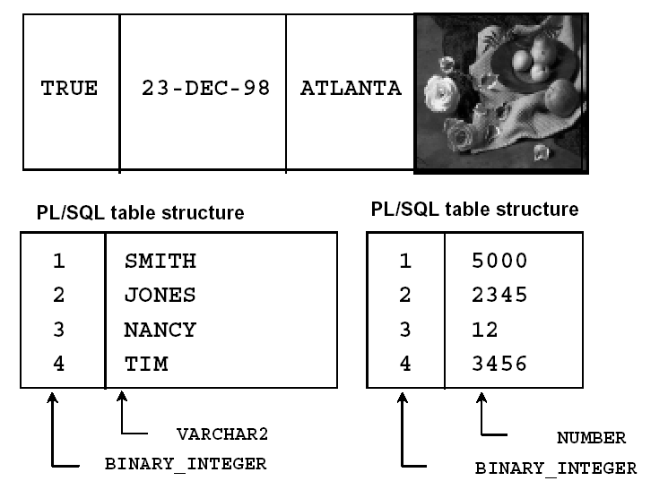
Composite Datatypes
The above reflects Oracle’s current development plans which are subject to change at any time

Slide 24
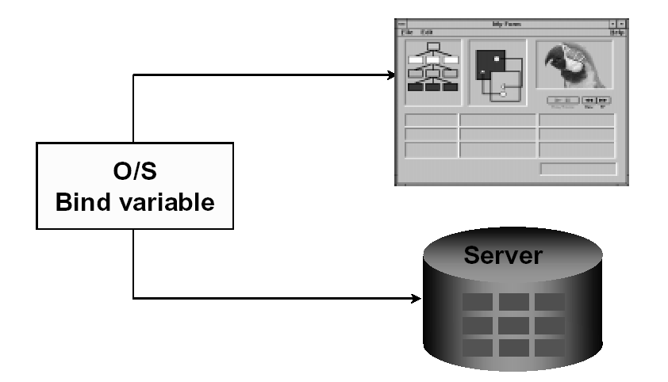
Bind Variables
The above reflects Oracle’s current development plans which are subject to change at any time

Slide 25
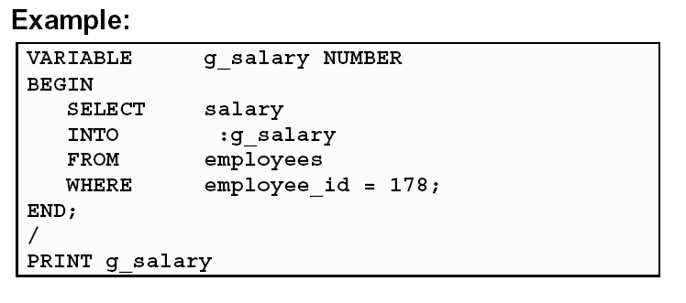
Using Bind Variables
To reference a bind variable in PL/SQL, you must prefix its name with a colon (:)
The above reflects Oracle’s current development plans which are subject to change at any time

Slide 26
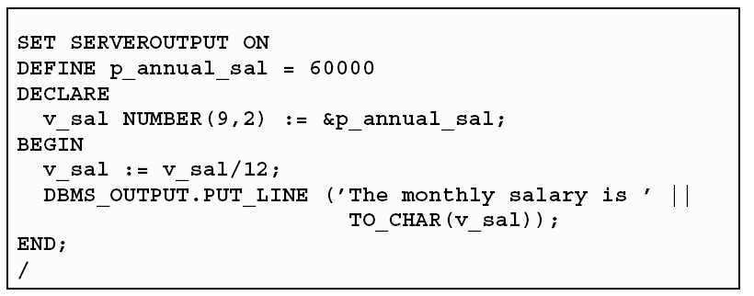
DBMS_OUTPUT.PUT_LINE
An Oracle-supplied packaged procedure
An alternative for displaying data from a PL/SQL block
Must be enabled in SQL*Plus with
SET SERVEROUTPUT ON
The above reflects Oracle’s current development plans which are subject to change at any time

Slide 27
Writing Executable Statements
The above reflects Oracle’s current development plans which are subject to change at any time

Slide 28
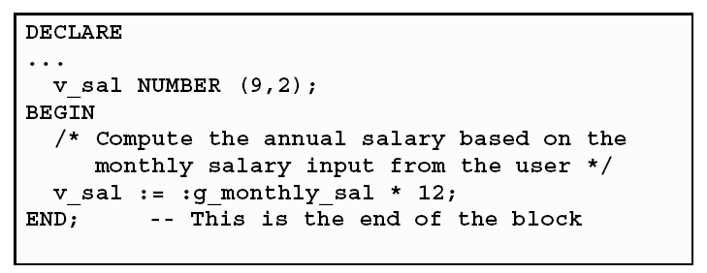
Commenting Codes
Prefix single-line comments with two dashes (--).
Place multiple-line comments between the symbols /* and */.
The above reflects Oracle’s current development plans which are subject to change at any time

Slide 29

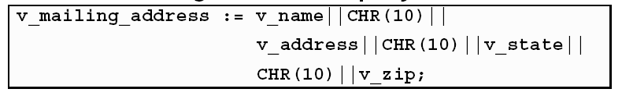
SQL Function in PL/SQL
Available in procedural statements:
  Single-row number
  Single-row character
  Data type conversion
  Date
Not available in procedural statements:
  DECODE
  Group functions
Same as SQL
The above reflects Oracle’s current development plans which are subject to change at any time

Slide 30
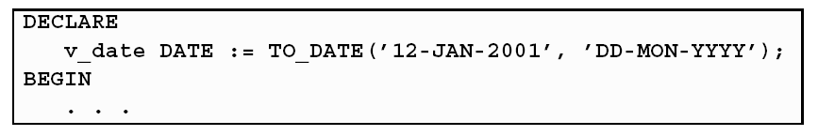
Data type Conversion
Convert data to comparable data types.
Mixed data types can result in an error and affect performance
Conversion functions:
-TO_CHAR
-TO_DATE
-TO_NUMBER
The above reflects Oracle’s current development plans which are subject to change at any time

Slide 31
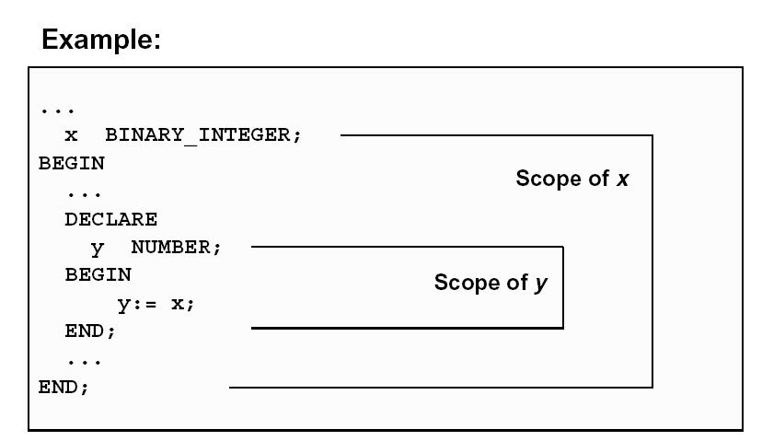
Nested Block and Variable Scope
The above reflects Oracle’s current development plans which are subject to change at any time

Slide 32
Operators in PL/SQL
Logical
Arithmetic
Concatenation
Parentheses to control
order of operations
Same as SQL
The above reflects Oracle’s current development plans which are subject to change at any time

Slide 33
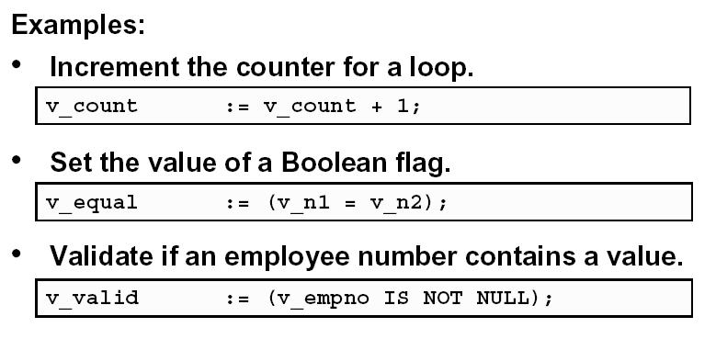
Operators in PL/SQL
The above reflects Oracle’s current development plans which are subject to change at any time

Slide 34
Programming Guideline
Make code maintenance easier by:
Documenting code with comments
Developing a case convention for the code
Developing naming conventions for identifiers and other objects
Enhancing readability by indenting
The above reflects Oracle’s current development plans which are subject to change at any time

Slide 35
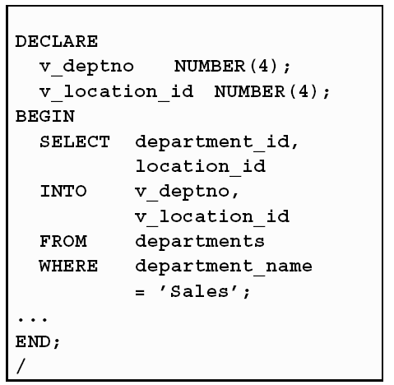
Indenting Code
For clarity, indent each level of code.
The above reflects Oracle’s current development plans which are subject to change at any time

Slide 36
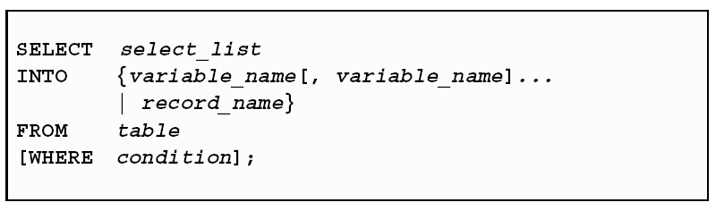
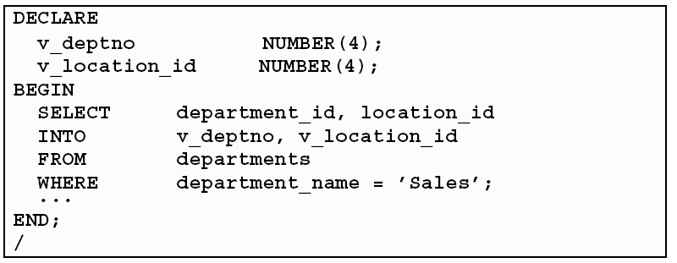
SELECT Statements in PL/SQL
Retrieve data from the database with a SELECT statement
The INTO clause is required.
Queries must return one and only one row
The above reflects Oracle’s current development plans which are subject to change at any time

Slide 37
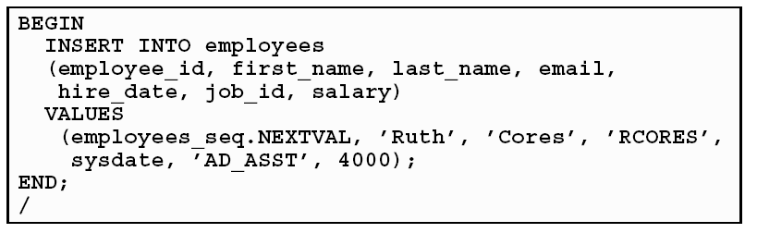
Inserting Data
The above reflects Oracle’s current development plans which are subject to change at any time

Slide 38
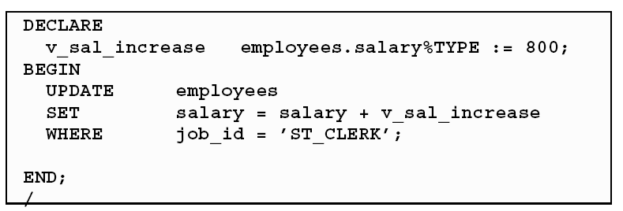
Updating Data
The above reflects Oracle’s current development plans which are subject to change at any time

Slide 39
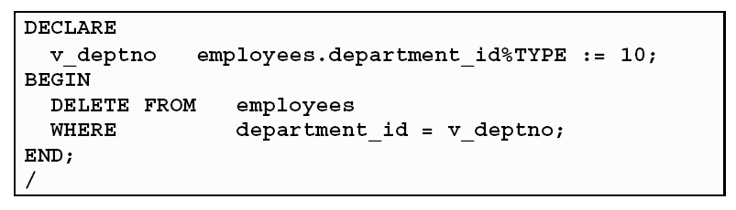
Deleting Data
The above reflects Oracle’s current development plans which are subject to change at any time

Slide 40
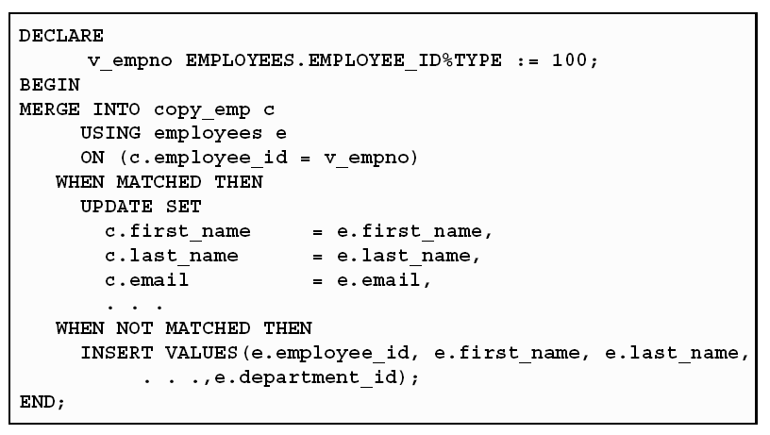
Merging Rows
The above reflects Oracle’s current development plans which are subject to change at any time

Slide 41
Writing Control Structures
The above reflects Oracle’s current development plans which are subject to change at any time

Slide 42
Controlling PL/SQL Flow of Execution
You can change the logical execution of
statements using conditional IF statements and loop control structures.
Conditional IF statements:
-IF-THEN-END IF
-IF-THEN-ELSE-END IF
-IF-THEN-ELSIF-END IF
The above reflects Oracle’s current development plans which are subject to change at any time

Slide 43
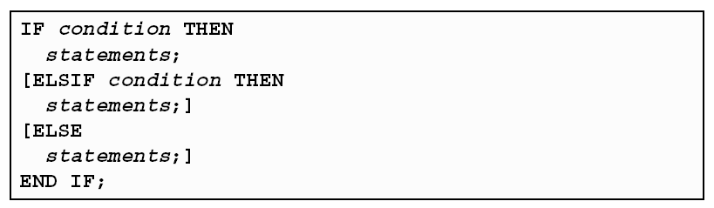
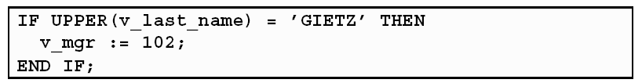
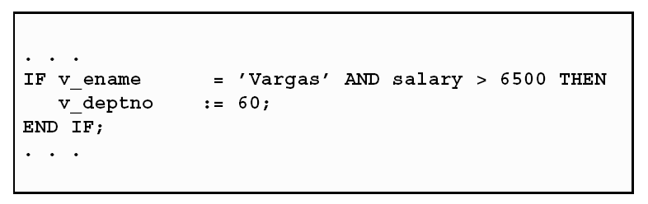
IF Statements
The above reflects Oracle’s current development plans which are subject to change at any time

Slide 44
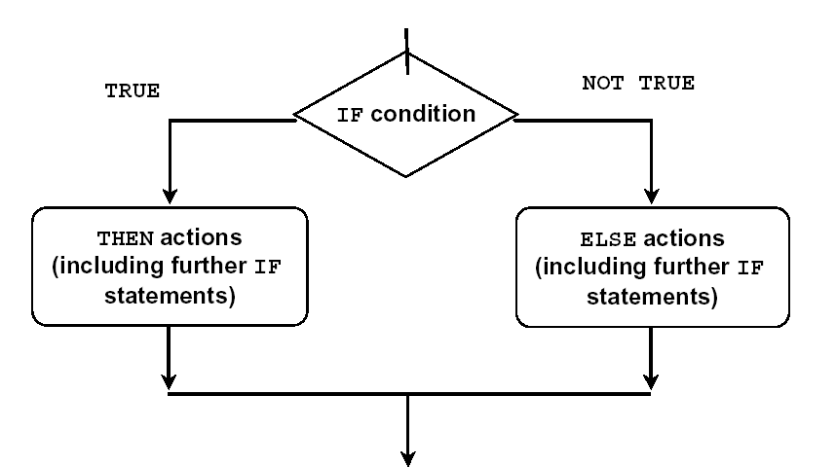
IF-THEN-ELSE Statement Execution Flow
The above reflects Oracle’s current development plans which are subject to change at any time

Slide 45
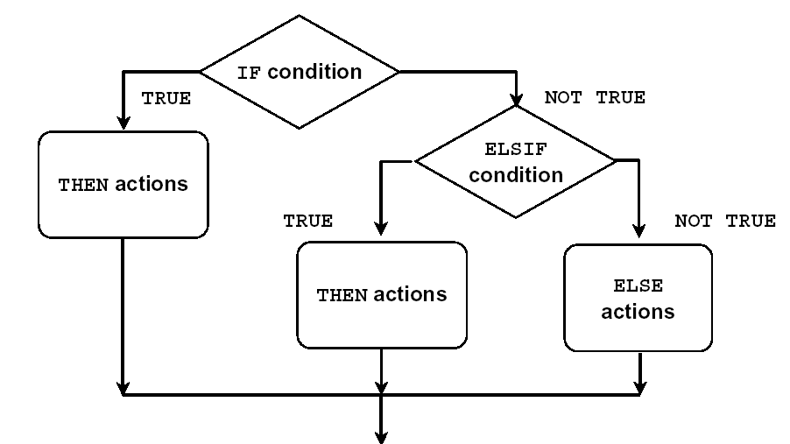
IF-THEN-ELSIF
Statement Execution Flow
The above reflects Oracle’s current development plans which are subject to change at any time

Slide 46
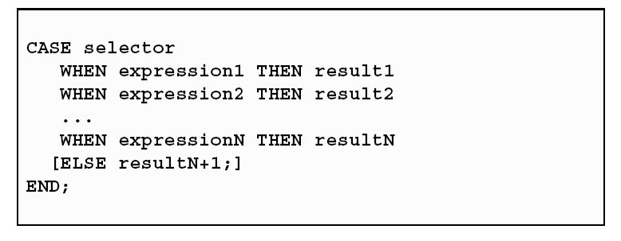
CASE Expressions
A CASE expression selects a result and returns it.
To select the result, the CASE expression uses an expression whose value is used to select one of several alternatives
The above reflects Oracle’s current development plans which are subject to change at any time

Slide 47
Handling Nulls
When working with nulls, you can avoid some
common mistakes by keeping in mind the following
rules:
  Simple comparisons involving nulls always yield NULL.
  Applying the logical operator NOT to a null yields
  NULL.
  In conditional control statements, if the condition
  yields NULL, its associated sequence of statements
  is not executed.
The above reflects Oracle’s current development plans which are subject to change at any time

Slide 48
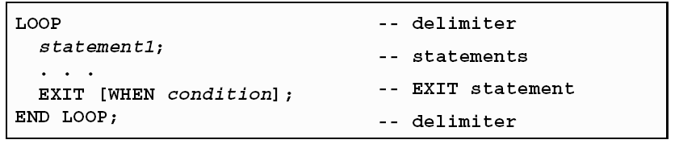
Iterative Control: LOOP Statements
Loops repeat a statement or sequence of
statements multiple times.
There are three loop types:
-Basic loop
-FOR loop
-WHILE loop
The above reflects Oracle’s current development plans which are subject to change at any time

Slide 49
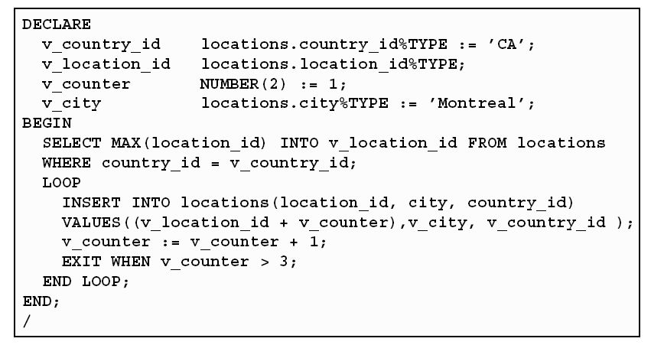
Basic Loops
The above reflects Oracle’s current development plans which are subject to change at any time

Slide 50
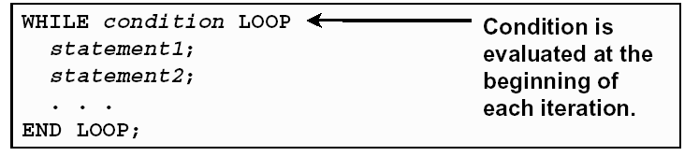
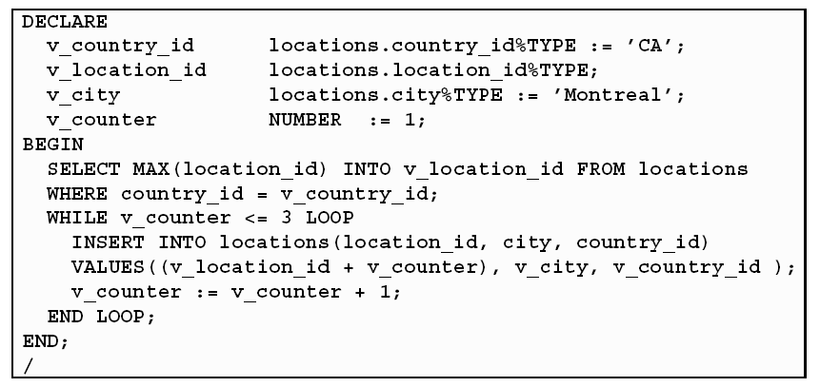
While loop
The above reflects Oracle’s current development plans which are subject to change at any time

Slide 51
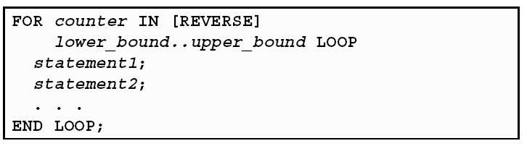
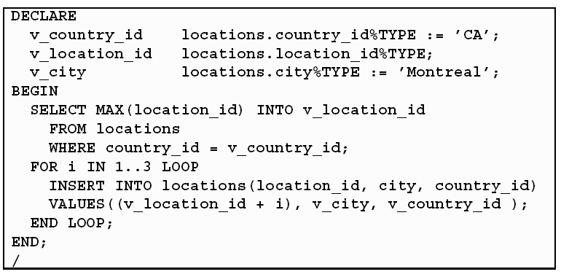
FOR Loops
The above reflects Oracle’s current development plans which are subject to change at any time

Slide 52
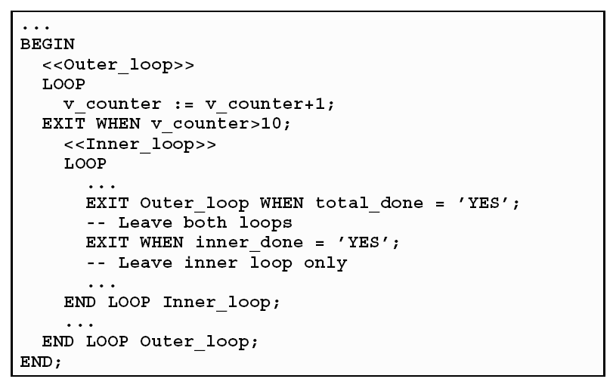
Nested Loops and Labels
The above reflects Oracle’s current development plans which are subject to change at any time

Slide 53
Working With Composite Data Types
The above reflects Oracle’s current development plans which are subject to change at any time

Slide 54
Composite Data Types
Are of two types:
- PL/SQL RECORDs
- PL/SQL Collections
      .INDEX BY Table
      .Nested Table
      .VARRAY
Contain internal components
Are reusable
The above reflects Oracle’s current development plans which are subject to change at any time

Slide 55
PL/SQL Records
Must contain one or more components of any scalar, RECORD, or INDEX BY table data type, called fields
Are not the same as rows in a database table
Treat a collection of fields as a logical unit
Are convenient for fetching a row of data from a table for processing
The above reflects Oracle’s current development plans which are subject to change at any time

Slide 56
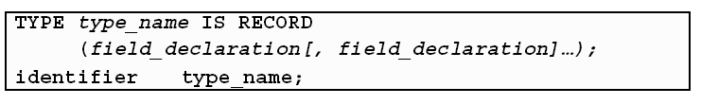

Creating a PL/SQL Record
The above reflects Oracle’s current development plans which are subject to change at any time

Slide 57
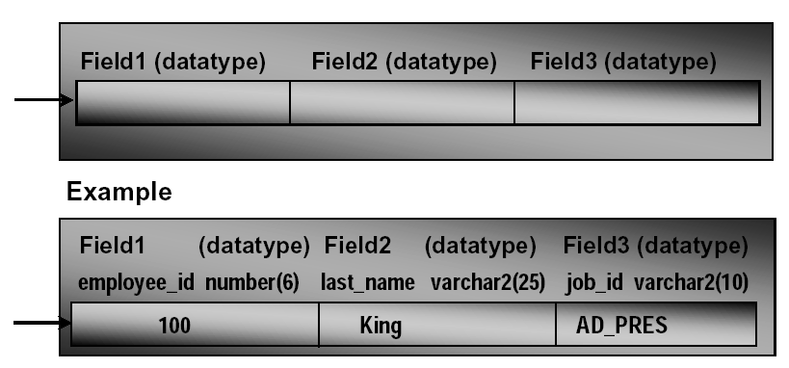
PL/SQL Record Structure
The above reflects Oracle’s current development plans which are subject to change at any time

Slide 58
The %ROWTYPE Attribute
Declare a variable according to a collection of columns in a database table or view.
Prefix %ROWTYPE with the database table.
Fields in the record take their names and data types from the columns of the table or view.
The above reflects Oracle’s current development plans which are subject to change at any time

Slide 59
The %ROWTYPE Attribute
Examples:
Declare a variable to store the information about a department from the DEPARTMENTS table.
Declare a variable to store the information about an employee from the EMPLOYEES table
The above reflects Oracle’s current development plans which are subject to change at any time

Slide 60
Writing Explicit Cursor
The above reflects Oracle’s current development plans which are subject to change at any time

Slide 61
About Cursors
Every SQL statement executed by the Oracle Server has an individual cursor associated with it:
  Implicit cursors: Declared for all DML and PL/SQL SELECT statements
  Explicit cursors: Declared and named by the programmer
The above reflects Oracle’s current development plans which are subject to change at any time

Slide 62
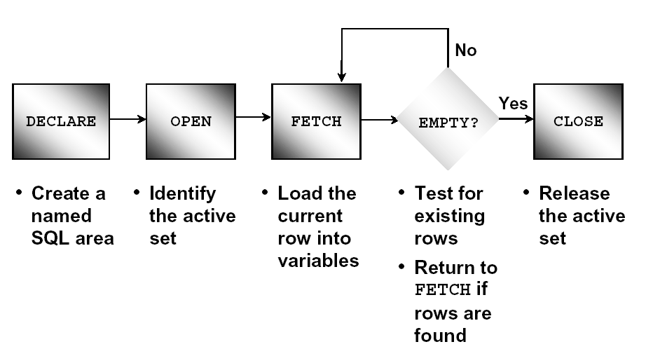
Controlling Explicit Cursors
The above reflects Oracle’s current development plans which are subject to change at any time

Slide 63
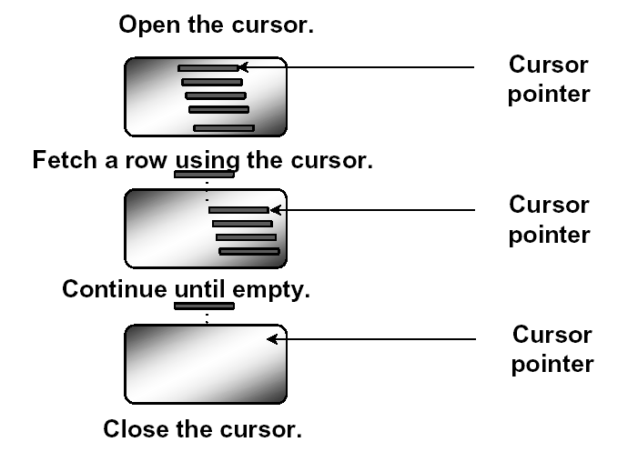
Controlling Explicit Cursors
The above reflects Oracle’s current development plans which are subject to change at any time

Slide 64
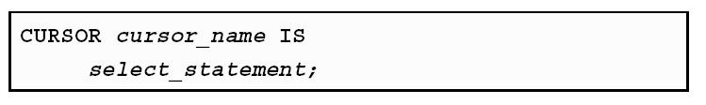
Declaring the Cursor
Syntax:
Do not include the INTO clause in the cursor declaration.
If processing rows in a specific sequence is required, use the ORDER BY clause in the query.
The above reflects Oracle’s current development plans which are subject to change at any time

Slide 65
Opening the Cursor
Sintax :
Open the cursor to execute the query and identify the active set.
If the query returns no rows, no exception is raised.
Use cursor attributes to test the outcome after a fetch.
The above reflects Oracle’s current development plans which are subject to change at any time

Slide 66
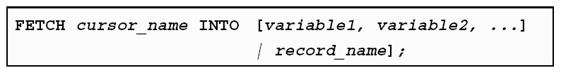
Fetching Data from the Cursor
Syntax:
Retrieve the current row values into variables.
Include the same number of variables.
Match each variable to correspond to the columnspositionally.
Test to see whether the cursor contains rows.
The above reflects Oracle’s current development plans which are subject to change at any time

Slide 67
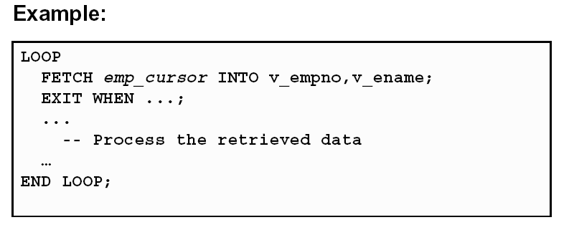
Fetching Data from the Cursor
The above reflects Oracle’s current development plans which are subject to change at any time

Slide 68
Closing the Cursor
Sintax :
Close the cursor after completing the processing of the rows
Reopen the cursor, if required
Do not attempt to fetch data from a cursor after it has been closed.
The above reflects Oracle’s current development plans which are subject to change at any time

Slide 69
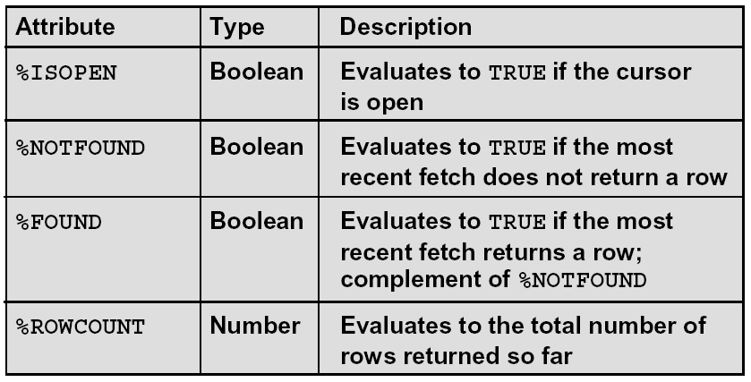
Explicit Cursor Attributes
Obtain status information about a cursor.
The above reflects Oracle’s current development plans which are subject to change at any time

Slide 70
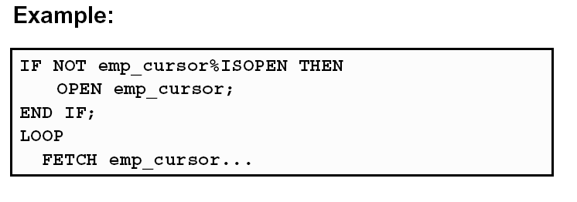
The %ISOPEN Attribute
Fetch rows only when the cursor is open.
Use the %ISOPEN cursor attribute before
performing a fetch to test whether the cursor is open.
The above reflects Oracle’s current development plans which are subject to change at any time

Slide 71
The %NOTFOUND and %ROWCOUNT Attributes
Use the %ROWCOUNT cursor attribute to retrieve an exact number of rows
Use the %NOTFOUND cursor attribute to determine when to exit the loop.
The above reflects Oracle’s current development plans which are subject to change at any time

Slide 72
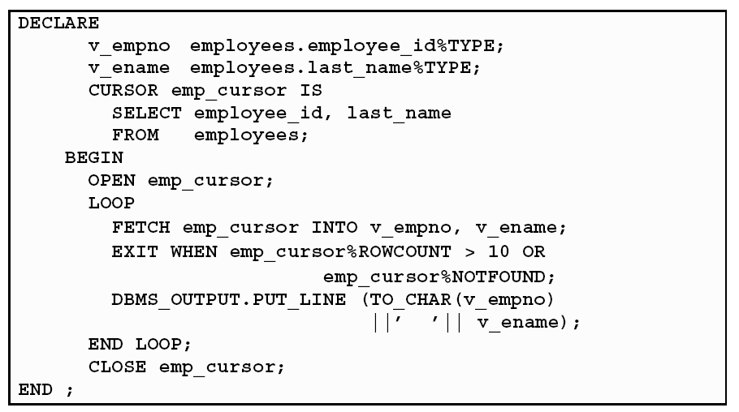
Example
The above reflects Oracle’s current development plans which are subject to change at any time

Slide 73
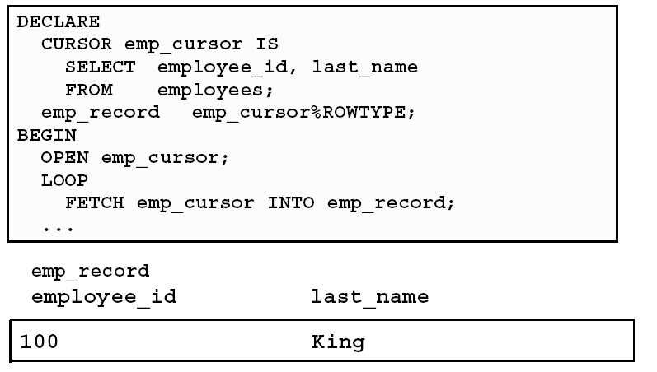
Cursors and Records
Process the rows of the active set by fetching values into a PL/SQL RECORD.
The above reflects Oracle’s current development plans which are subject to change at any time

Slide 74

Cursor FOR Loops
Syntax:
The cursor FOR loop is a shortcut to process explicit cursors.
Implicit open, fetch, exit, and close occur.
The record is implicitly declared.
The above reflects Oracle’s current development plans which are subject to change at any time

Slide 75
Handling Exceptions
The above reflects Oracle’s current development plans which are subject to change at any time

Slide 76
Handling Exceptions with PL/SQL
An Exception is an identifier in PL/SQL that is raised during execution
How is it raised?
-An Oracle error occurs.
-You raise it explicitly.
How do you handle it?
-Trap it with a handler.
-Propagate it to the calling environment.
The above reflects Oracle’s current development plans which are subject to change at any time

Slide 77

Handling Exceptions
The above reflects Oracle’s current development plans which are subject to change at any time

Slide 78

Trapping Exceptions
The above reflects Oracle’s current development plans which are subject to change at any time

Slide 79
Trapping Exceptions Guidelines
The EXCEPTION keyword starts exception-handling section
Several exception handlers are allowed.
Only one handler is processed before leaving the block
WHEN OTHERS is the last clause.
The above reflects Oracle’s current development plans which are subject to change at any time

Slide 80
Trapping Predefined Oracle Server Errors
Reference the standard name in the exception-handling routine
Sample predefined exceptions:
-NO_DATA_FOUND
-TOO_MANY_ROWS
-ZERO_DIVIDE
-DUP_VAL_ON_INDEX
The above reflects Oracle’s current development plans which are subject to change at any time

Slide 81

Predefined Exceptions
The above reflects Oracle’s current development plans which are subject to change at any time

Slide 82
Functions for Trapping Exceptions
SQLCODE: Returns the numeric value for the error code
SQLERRM: Returns the message associated with the error number
The above reflects Oracle’s current development plans which are subject to change at any time

Slide 83

Functions for Trapping Exceptions
The above reflects Oracle’s current development plans which are subject to change at any time

Slide 84
Creating Procedure
The above reflects Oracle’s current development plans which are subject to change at any time

Slide 85
Overview of Subprograms
A subprogram:
Is a named PL/SQL block that can accept parameters and be invoked from a calling environment
Is of two types:
-A procedure that performs an action
-A function that computes a value
The above reflects Oracle’s current development plans which are subject to change at any time

Slide 86

Block Structure for Anonymous
PL/SQL Blocks
The above reflects Oracle’s current development plans which are subject to change at any time

Slide 87

Block Structure for PL/SQL Subprograms
The above reflects Oracle’s current development plans which are subject to change at any time

Slide 88
What Is a Procedure?
A procedure is a type of subprogram that performs an action.
A procedure can be stored in the database, as a schema object, for repeated execution.
The above reflects Oracle’s current development plans which are subject to change at any time

Slide 89

Syntax for Creating Procedures
The REPLACE option indicates that if the procedure exists, it will be dropped and replaced with the new version created by the statement
PL/SQL block starts with either BEGIN or the declaration of local variables and ends with either END or END procedure_name
The above reflects Oracle’s current development plans which are subject to change at any time

Slide 90

Procedural Parameter Modes
The above reflects Oracle’s current development plans which are subject to change at any time

Slide 91

Creating Procedures with Parameters
The above reflects Oracle’s current development plans which are subject to change at any time

Slide 92

IN Parameters: Example
The above reflects Oracle’s current development plans which are subject to change at any time

Slide 93

OUT Parameters: Example
The above reflects Oracle’s current development plans which are subject to change at any time

Slide 94


OUT Parameters: Example
The above reflects Oracle’s current development plans which are subject to change at any time

Slide 95

IN OUT Parameters
The above reflects Oracle’s current development plans which are subject to change at any time

Slide 96

DEFAULT Option for Parameters
The above reflects Oracle’s current development plans which are subject to change at any time

Slide 97
Creating Function
The above reflects Oracle’s current development plans which are subject to change at any time

Slide 98
Overview of Stored Functions
A function is a named PL/SQL block that returns a value
A function can be stored in the database as a schema object for repeated execution
A function is called as part of an expression
The above reflects Oracle’s current development plans which are subject to change at any time

Slide 99

Syntax for Creating Functions
The PL/SQL block must have at least one RETURN statement
The above reflects Oracle’s current development plans which are subject to change at any time

Slide 100

Function : Example
The above reflects Oracle’s current development plans which are subject to change at any time

Slide 101
Executing Functions
Invoke a function as part of a PL/SQL expression.
Create a variable to hold the returned value.
Execute the function. The variable will be
populated by the value returned through a RETURN statement.
The above reflects Oracle’s current development plans which are subject to change at any time

Slide 102

Procedure or Function?
The above reflects Oracle’s current development plans which are subject to change at any time

Slide 103
Creating Packages
The above reflects Oracle’s current development plans which are subject to change at any time

Slide 104
Overview of Packages
Packages:
Group logically related PL/SQL types, items, and subprograms
Consist of two parts:
-Specification
-Body
Cannot be invoked, parameterized, or nested
Allow the Oracle server to read multiple objects
into memory at once
The above reflects Oracle’s current development plans which are subject to change at any time

Slide 105

Components of a Package
The above reflects Oracle’s current development plans which are subject to change at any time

Slide 106

Referencing Package Objects
The above reflects Oracle’s current development plans which are subject to change at any time

Slide 107

Creating the Package Specification
Sintax :
The REPLACE option drops and recreates the package specification
Variables declared in the package specification are initialized to NULL by default.
All the constructs declared in a package
specification are visible to users who are granted
privileges on the package
The above reflects Oracle’s current development plans which are subject to change at any time

Slide 108

Creating Package : Example
The above reflects Oracle’s current development plans which are subject to change at any time

Slide 109

Creating the Package Body
Syntax:
The REPLACE option drops and recreates the
package body.
Identifiers defined only in the package body are
private constructs. These are not visible outside
the package body.
All private constructs must be declared before
they are used in the public constructs.
The above reflects Oracle’s current development plans which are subject to change at any time

Slide 110

Creating a Package Body: Example
The above reflects Oracle’s current development plans which are subject to change at any time

